Slide 1

OSeMOSYS

Slide 2
Outline
Energy and electricity systems modelling
Electricity systems modelling
Introduction to electricity modelling in OSeMOSYS

Slide 3
3. Introduction to electricity modelling in OSeMOSYS Objective: Understand linear programing electricity modelling in OSeMOSYS

Slide 4
Models in electricity systems planning and analysis
Stability analysis
Load flow analysis
Electricity market analysis
Long-term electricity system analysis
Notes:
Various models for energy systems planning exist, with different functions. OSeMOSYS is among the long-term energy system analysis models, useful for studying the impacts of long-term strategies.
Its results may be inputs to shorter-term models, used for the specific design of energy systems. For instance, one could: 1) use a long-term energy system model to compute the optimal electricity mix in every year until 2050, and 2) use the resulting optimal electricity mix in one specific year (e.g., 2030) as an input to a detailed electricity market model more suitable for the study of short periods.

Slide 5

Open Source energy MOdelling SYStem (OSeMOSYS)
www.osemosys.org
M. Howells et al. (2011), OSeMOSYS: The Open Source Energy Modeling System: An introduction to its ethos, structure and development. Energy Policy.
Model generator converting the energy system structure represented by equations into a matrix to be solved by specific solvers
Open source
Deterministic
Dynamic
Perfect foresight
Paradigm comparable to MESSAGE or TIMES
Linear optimization
Notes:
What does it mean that the energy system structure is represented by equations? It means that the physical relations between parts of the system are represented by mathematical formulations such as:
Supply >= demand
Production by technology <= maximum production by technology
Total emissions <= emissions limits
Etc.
A model generator means that OSeMOSYS provides the mathematical structure, while the user can create the representation of every energy system he/she wants.
Openness relates also to data. It is difficult to know the combined uncertainty of big sets of data to be fed into the model; more difficult is to understand how this uncertainty is amplified in the model results. But, if the data are open and accompanied by metadata, they can be checked and replaced. If the model is open source, everyone can track where results come from. This could also be useful to policymakers to justify how numbers are derived.
Deterministic means it does not consider any quantity with its probability distribution. Both inputs and outputs are deterministic quantities. The uncertainty over the inputs can be spanned by varying that quantity over different scenarios.
Dynamic means it is able to study how the energy mix evolves every year throughout the time domain we assume.
Linear optimization means the objective function and all the equations representing the structure of the energy system are linear. This allows the model to be detailed enough but at the same time fast to run.
Perfect foresight means that we assume OSeMOSYS knows in advance how demand, fuel prices, the cost of technologies, etc. will evolve during the whole time domain and optimizes the energy system consequently.
Comparisons are present in literature, e.g., between TIMES and OSeMOSYS.

Slide 6
What does OSeMOSYS do?
It determines the energy system configuration with the minimum total discounted cost for a time domain of decades, constrained by:
Demand for energy (e.g., electricity, heating, cooling, km-passengers, etc.) that needs to be met
Available technologies and their techno-economic characteristics (levelized cost of electricity, efficiency, lifetime, etc.)
Emissions taxation, generation targets (e.g., renewables)
Other constraints (e.g., ramping capability, availability of resources, investment decisions, etc.)
Notes:
The “energy system configuration” means, among others: 1) the annual installed capacity of every technology, 2) its production in every time slice, and 3) the capital, fixed and variable costs relative to every technology and to the whole system.
The demand for energy, available technologies, emissions taxation, etc. are all inputs fed in by the user. Therefore, a very important and time-consuming step before modelling is gathering and pre-processing all necessary input data!

Slide 7
What is linear programming ?
A special case of mathematical programming that can be represented by linear relationships
Devoped by Leonid Kantorovich in 1939 for use during World War II to plan expenditures and returns – minimize costs to the army and maximize losses to the enemy
Kept secret till 1947
Now used in energy system planning, banking, education, forestry, petroleum, and logistics
Survey of Fortune 500 firms: 85 per cent said they had used linear programming¹
Linear programing consists of:
A linear objective function subject to linear equalities and/or linear inequalities
¹ From W. L. Winston (2004), Operations Research: Applications and Algorithms. 4th Edition. Thomson.

Slide 8
Linear programming – a simple example Optimal allocation of oil and gas for electricity generation
Oil
Policy and operational constraints determine solution space
Objective function: system cost minimization – minimize z = cx
Subject to: Ax = b, x ≥ 0
Maximum oil import
Solution space
Oil and gas for
electricity generation
Max CO₂
Oil use for transport
Natural gas

Slide 9
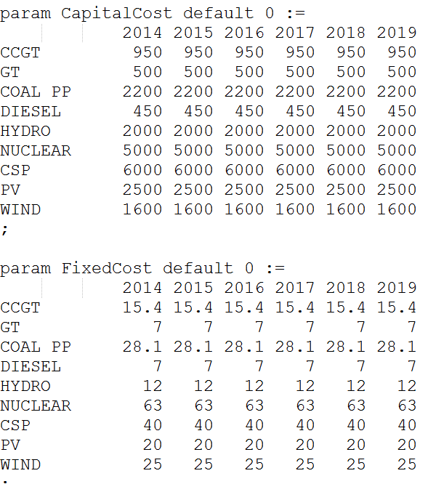
OSeMOSYS input parameters
Existing historical capacity
Fuel costs
Capital costs
Operations/maintenance costs
Efficiency
Ramping characteristics
Emission factors
Production targets
Investment constraints
Taxation on emissions
Availability of resources
Etc....
Notes:
This slide lists some of the main inputs related to technologies and their operations, which can be fed and controlled by the user in an application with OSeMOSYS.
In the figure, an extract from an input file for OSeMOSYS is shown, representing part of the fixed, capital and variable cost inputs for different technologies for an imaginary country called “UTOPIA.”

Slide 10
Input parameters
Data collection
Electricity demand projections
Primary resources potentials
Existing capacity
Technology costs and characteristics
Country/region specific constraints
Fuel prices
Data pre-processing
Adapting demand curves to model
Assume data if not available
Validate data with governments
Define the starting year for the modelling (a past year with sound actual data)
Tweak inputs such that modelling outputs resemble actual performance
Model calibration
Notes:
A fundamental question is: how to collect and feed data into a model? How important, difficult and long is this step?
The phases of data collection, pre-processing and model calibration are the most important of the whole exercise, and often the longest and most resource intensive.

Slide 11
Interpreting modelling results
The results answer questions such as:
Which technologies are phasing out? By when?
What are the optimal investments in new technologies to meet the demand in the future? When is it best to invest?
What are the key generation technologies in the total energy mix?
Which capacities are NOT being utilized? Why?
What costs will the energy system incur?

Slide 12
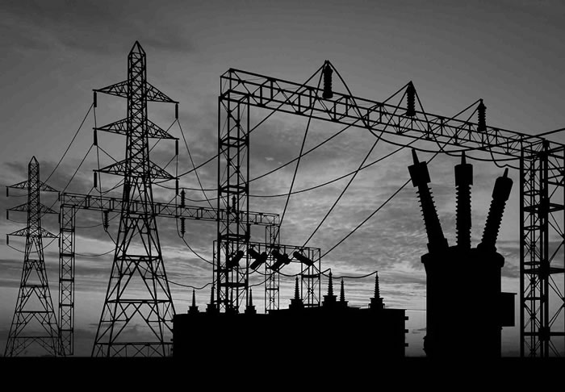

Interpreting modelling results
What would be the impact of large swings in oil prices?
Can we fully rely on renewables?
If not, what is the maximum share of renewables that the energy system can accommodate? Can it be financed?
Should the tax on transport fuels increase to encourage the use of public transportation?
Would switching to "advanced technologies" allow us to continue improving living standards and simultaneously avoid climate change?
Can we really afford heavy upfront investment technologies? For example, wind, CSP, PV, hydro, etc.?
What is the impact of energy efficiency measures on the supply mix?
Notes:
The policy questions listed previously (here reported again) can be answered by models in OSeMOSYS, depending on how the model is set and which data are fed in.

Slide 13
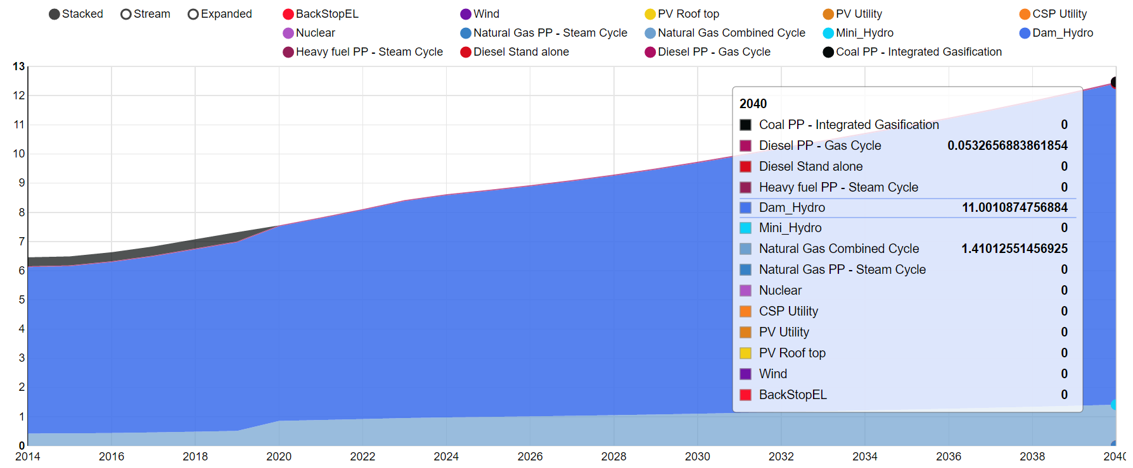
Representative OSeMOSYS results
Hydro and CCGT most competitive
Electricity generation (PJ)
Initial capacity of COAL PP phased out at end of life
Year
Notes:
What to look at?
Which technologies are being introduced to the system and when?
Which technologies are phasing out and when?
Which technologies dominate?
A certain technology can have a large capacity but a small share in the generation mix, for reasons including it being used for peak demand only (e.g., diesel to back up hydro).
The least cost means that this is the lowest cost of the overall system cost but not necessarily for the particular country.

Slide 14
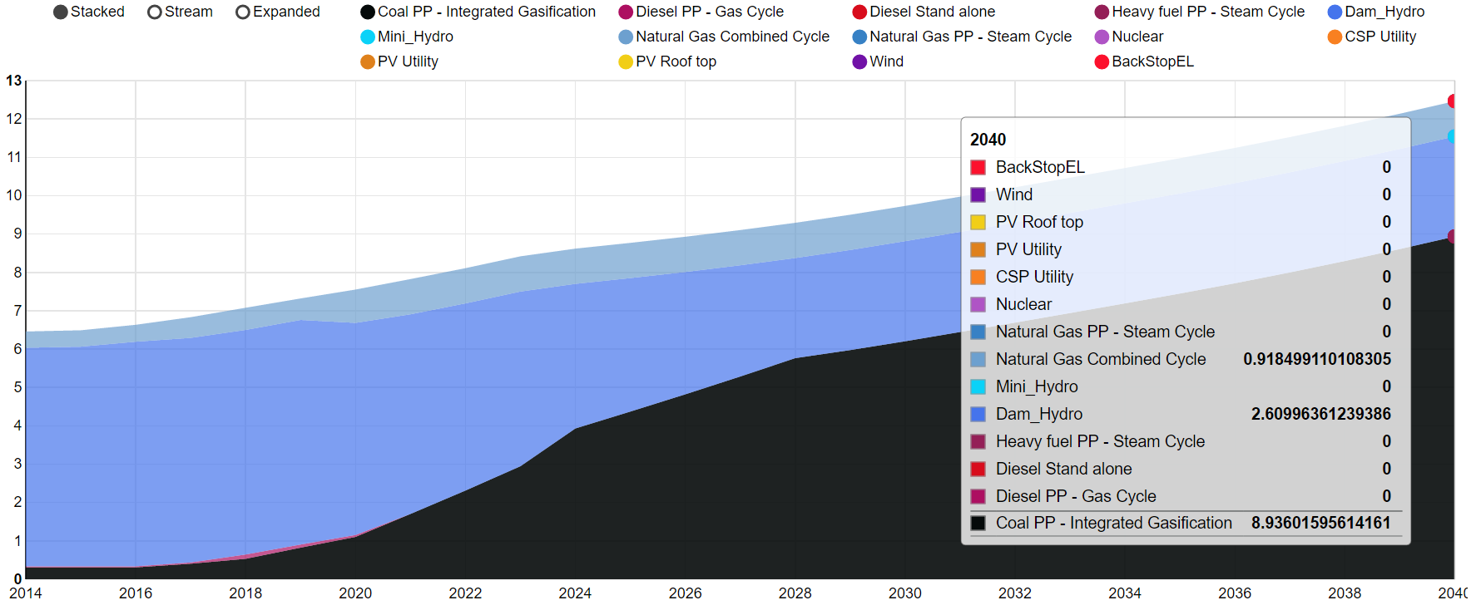
Representative OSeMOSYS results
What happens in a climate change adaptation scenario?
Electricity generation (PJ)
More generation from COAL PP, less reliance on HYDRO
Year

Slide 15
THANK YOU
OSeMOSYS
www.osemosys.org

